Slide 1
Project 3 Presentation: Trajectories of Onset of Memory/Cognitive Loss
Rachel Johnson

Slide 2
Introduction & Data Summary
(study, data, data cleaning, table 1) ***REORGANIZE AROUND HERE!
 |  | Overall | Did not develop dementia/MCI during study | Developed dementia/MCI during study
n |  | 187 | 119 | 68
Number observations (mean (sd)) |  | 17.49 (7.48) | 16.42 (8.22) | 19.35 (5.54)
Years of follow-up (mean (sd)) |  | 8.82 (4.05) | 8.23 (4.41) | 9.87 (3.08)
Gender (%) | Male | 82 (43.9) | 59 (49.6) | 23 (33.8)
 | Female | 105 (56.1) | 60 (50.4) | 45 (66.2)
SES (mean (sd)) |  | 49.32 (11.68) | 49.66 (10.86) | 48.74 (13.07)
Age (mean (sd)) |  | 80.10 (8.87) | 77.16 (8.92) | 85.24 (6.01)
BlockR (mean (sd)) |  | 24.56 (9.36) | 26.52 (9.43) | 21.12 (8.22)
Animals (mean (sd)) |  | 17.33 (5.11) | 18.30 (4.99) | 15.62 (4.91)
LogMemI (mean (sd)) |  | 13.48 (4.36) | 14.60 (4.02) | 11.53 (4.28)
LogMemII (mean (sd)) |  | 11.13 (5.00) | 12.55 (4.51) | 8.65 (4.88)

Slide 3
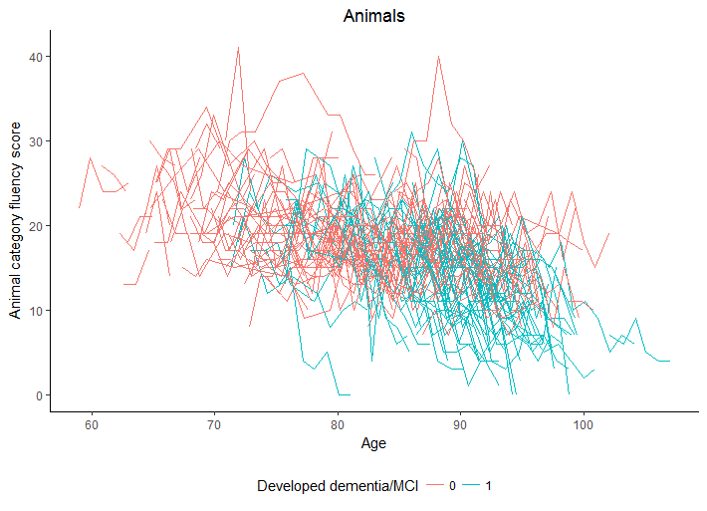
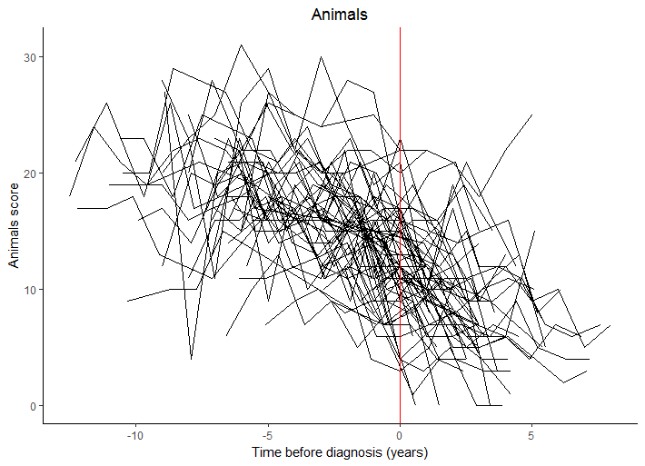
Data Visualization

Slide 4
Data Analysis Plan
Discuss CP by likelihood, mixed model that we fit (covs, outcome, cov structure), bootstrap for CP and new standard errors/p-vals

Slide 5
Analysis Results
Change point table, estimates table from model w/ new SEs

Slide 6
Conclusions & Limitations
Talk about change point w/ 95% CI
Discuss effects of bootstrapped SEs
Limitations
Had to have 3 data points to be included in study
Uncertainty of change pt?? Idk if that’s a limitation but it incr our SE’s…
Anything else???

